Slide 1


A
Project On
Music Audio Files Classification using Machine Learning
Presented By
Mr. Amitkumar M. Bande Mr. Sushant S. Chougule
Under the Guidance of
Mr. Abhijeet Nagargoje

Slide 2
Introduction
Overview:
Music genre classification is the process of automatically categorizing music tracks into predefined genres based on their audio features.
Importance:
Recommendation Systems
Content Organization
Music Streaming Services

Slide 3
Objectives
Main Goal:
Classify music tracks into distinct genres using machine learning techniques.
Sub-goals:
Explore and preprocess the dataset.
Train and evaluate different machine learning models.
Analyze the performance and accuracy of each model.

Slide 4
Dataset Overview
Widely recognized in the research community.
1000 audio clips, each 30 seconds long.
10 genres: Blues, Classical, Disco, Country, Hip-Hop,
Jazz, Metal, Pop, Reggae, Rock.
Audio Format: WAV files

Slide 5
Data Pre-processing
Feature Extraction :
Extract features like Mel-Frequency Cepstral Coefficients (MFCCs), chroma features, and spectral contrast.
Label Encoding :
Labels were encoded using one-hot encoding for compatibility with multi-class classification.
Data Splitting :
Split the data into training and testing sets.

Slide 6
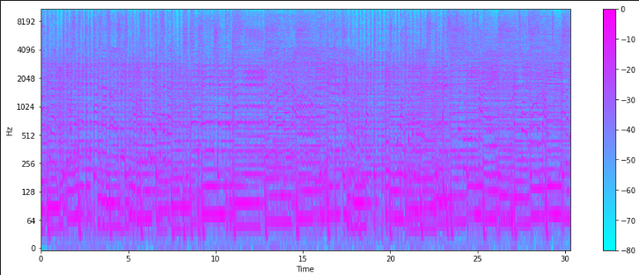
Spectrogram:

Slide 7
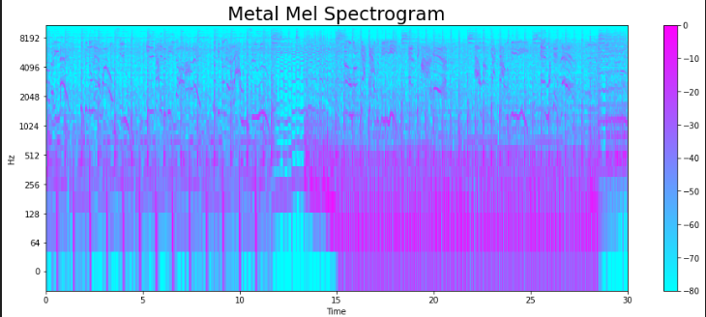
Melodic Spectrogram:

Slide 8
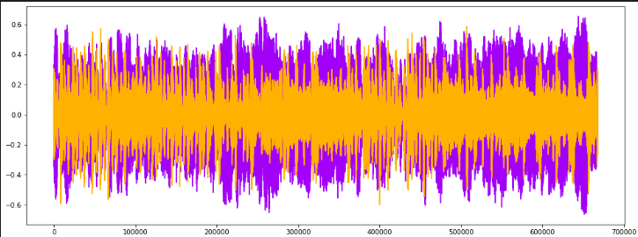
Harmonics and Perceptrual:

Slide 9
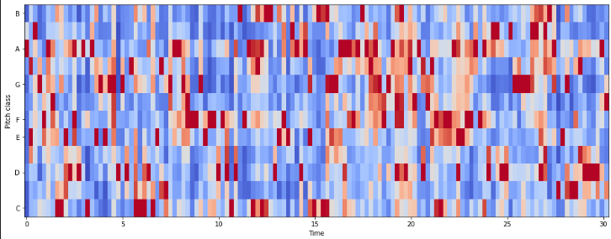
Chroma Frequencies:

Slide 10
Machine Learning Models
Models Used:
Random Forest Classifier
Support Vector Machine (SVM)
K-Nearest Neighbors (KNN)
Model Training:
Each model is trained on the training data, learning the underlying patterns and relationships between the input features (e.g., MFCCs, chroma features) and the target genres.

Slide 11
Deep Learning Approach
Neural Network Architecture:
Describe the Sequential model with multiple dense layers.
Explain the use of ReLU activation and dropout layers to
prevent overfitting.
Output Layer:
Softmax activation for multi-class classification.

Slide 12
Hyperparameter Optimization
Purpose:
Improve model performance by tuning hyperparameters.
Steps:
Define objective function.
Perform train-test split.
Apply optimization techniques.
Outcome:
KNN achieved the highest accuracy of 94% after optimization.

Slide 13
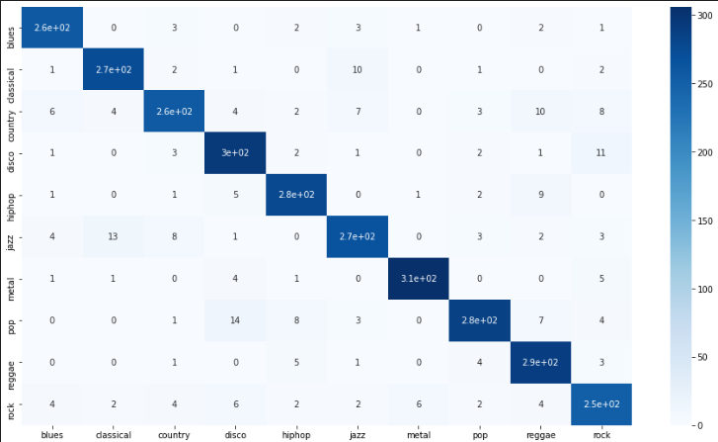
Model Evaluation
Performance Metrics:
Accuracy, Precision, Recall, F1-Score.
Comparison of model performance based on accuracy.
Confusion Matrix:

Slide 14
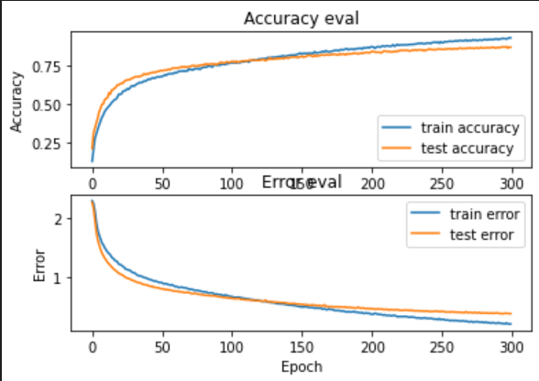
Plot Accuracy & Loss

Slide 15
Results and Analysis
Model Accuracy:
k-NN: Achieved accuracy of 76-80%.
SVM and Random Forest: Compare their performance.
Best Model: Highlight the best-performing model (e.g., k-NN).
Challenges: Discuss challenges like class imbalance or feature selection.

Slide 16
Conclusion
Summary:
CNN is a robust model for music genre classification with
limited data.
KNN can achieve higher accuracy but may involve overfitting
risks.
Future Work:
Explore additional datasets and techniques to further enhance
accuracy.

Slide 17
References
Convolutional Neural Network
A Comprehensive Guide to Convolutional Neural Networks — the ELI5 way | by Sumit Saha | Towards Data Science
Machine Learning Algorithms
RandomForestClassifier — scikit-learn 1.5.1 documentation
Random Forest: A Complete Guide for Machine Learning | Built In
1.4. Support Vector Machines — scikit-learn 1.5.1 documentation

